Slide 1

High Impact Skills Development Program
in Artificial Intelligence, Data Science, and Blockchain
Module 2: Unsupervised Learning
Lecture 1: Clustering
Instructor: Dr. Nazia Perwaiz
Assistant Professor, SEECS, NUST

Slide 2




Someone Messed Up the Library!
French
German
Spanish

Slide 3
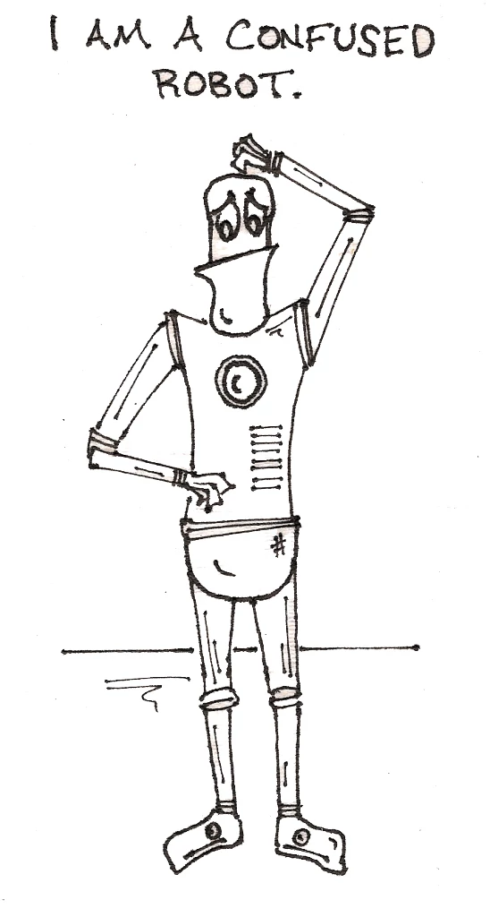
Someone Messed Up the Library!
French
German
Spanish

Slide 4
Supervised Learning
Feature 2
Feature 1

Slide 5
Unsupervised Learning
Feature 2
Feature 1

Slide 6
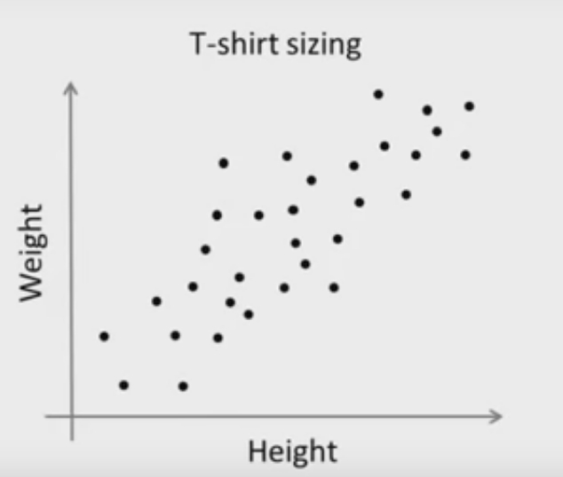
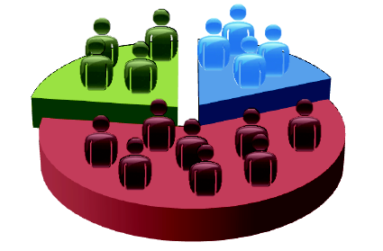

Unsupervised Learning

Slide 7
Supervised vs Unsupervised Learning
Properties | Unsupervised Learning | Supervised Learning
Definition | Type of machine learning that happens without human supervision and machine tries to find out the patterns in data itself | Type of machine learning that happens under human supervision, meaning people label input data with answer keys, that guided/ supervises the machine to learn the desired outputs
Input data | Unlabeled | Labeled
Use of data | Model is given only the input variables (X) and no corresponding output data | Model is given input variables (X), output variables (Y) and an algorithm to learn the function from input to output

Slide 8
Supervised vs Unsupervised Learning
Properties | Unsupervised Learning | Supervised Learning
When to use | You don’t know what you are looking for in data | You know what you are looking for in data
Applicable in | To identify patterns and relationships in data (Clustering and association problems) | To determine a specific output relating to classification and regression problems
Accuracy of results | May provide less accurate results | Provides more accurate results
Methods | Computationally Complex | Simple

Slide 9
Why/ When Unsupervised Learning?
Easier to get unlabeled data and less time-consuming
no need to manually label the data
Understanding raw data
To find unknown patterns to get useful insights from raw data
e.g. user categorization by their social media activity
Similar to human mind
baby-cat example

Slide 10
When Unsupervised Learning?
If you need to identify patterns and relationships in data
The data is pretty large
where labeling the data may be time-consuming or impractical

Slide 11
Applications of Unsupervised Learning
Medical diagnosis
Customer segmentation
Recommendation systems
Anomaly Detection
Cyber security
Preparing data for supervised learning

Slide 12
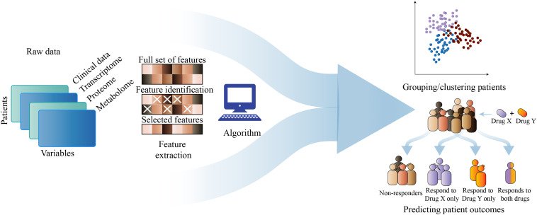
Applications of Unsupervised Learning
Medical diagnosis
Notes:
Medical Imaging: Unsupervised ML can serve as a great tool for improving medical imaging devices. It helps radiologists and physicians interpret images faster and helps them make more accurate medical diagnoses. Using it can be especially beneficial in situations when a medical facility has no human supervision available.

Slide 13
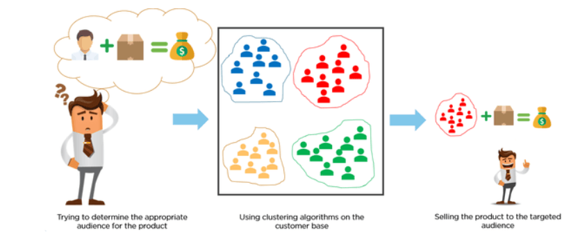
Applications of Unsupervised Learning
Customer segmentation
Notes:
Customer segmentation
Customer segmentation is the process of determining common characteristics between customers and dividing these customers into groups. Segmenting customers based on their behaviour, purchasing habits or demographics helps companies market to each group more effectively. Although many marketers and analysts do this manually thanks to analytics tools, unsupervised machine learning automates this process. In some instances, it can even make the results more accurate.

Slide 14
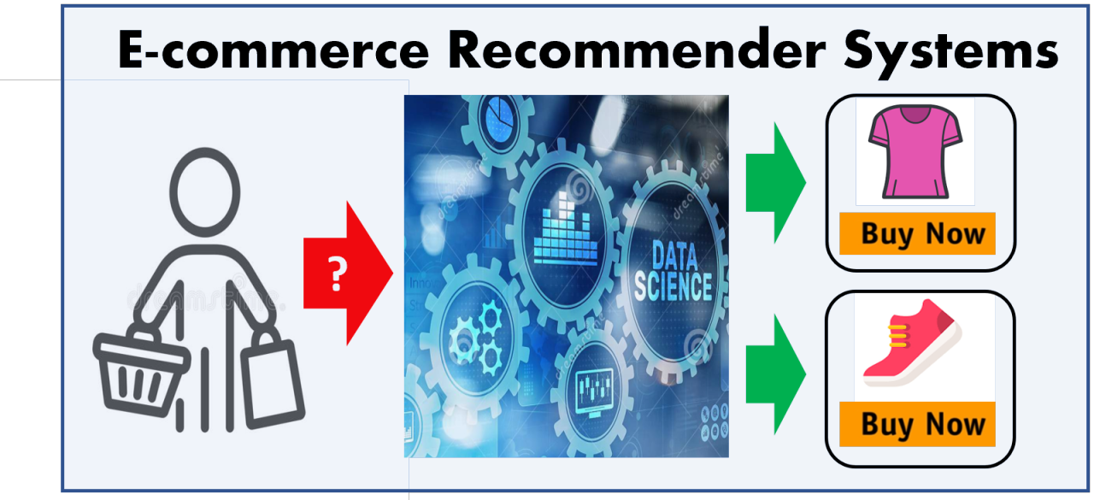
Applications of Unsupervised Learning
Recommendation systems
Notes:
Recommendation systems
Recommendation systems are algorithms that analyse your online activity and select information, products or websites that you might like based on the websites you visited or phrases for which you searched online. When companies use unsupervised ML, they can automatically analyse your data to predict your interests and recommend more similar content to you. A good example of this process is news sites that often recommend news to you based on the articles you viewed in the past.

Slide 15
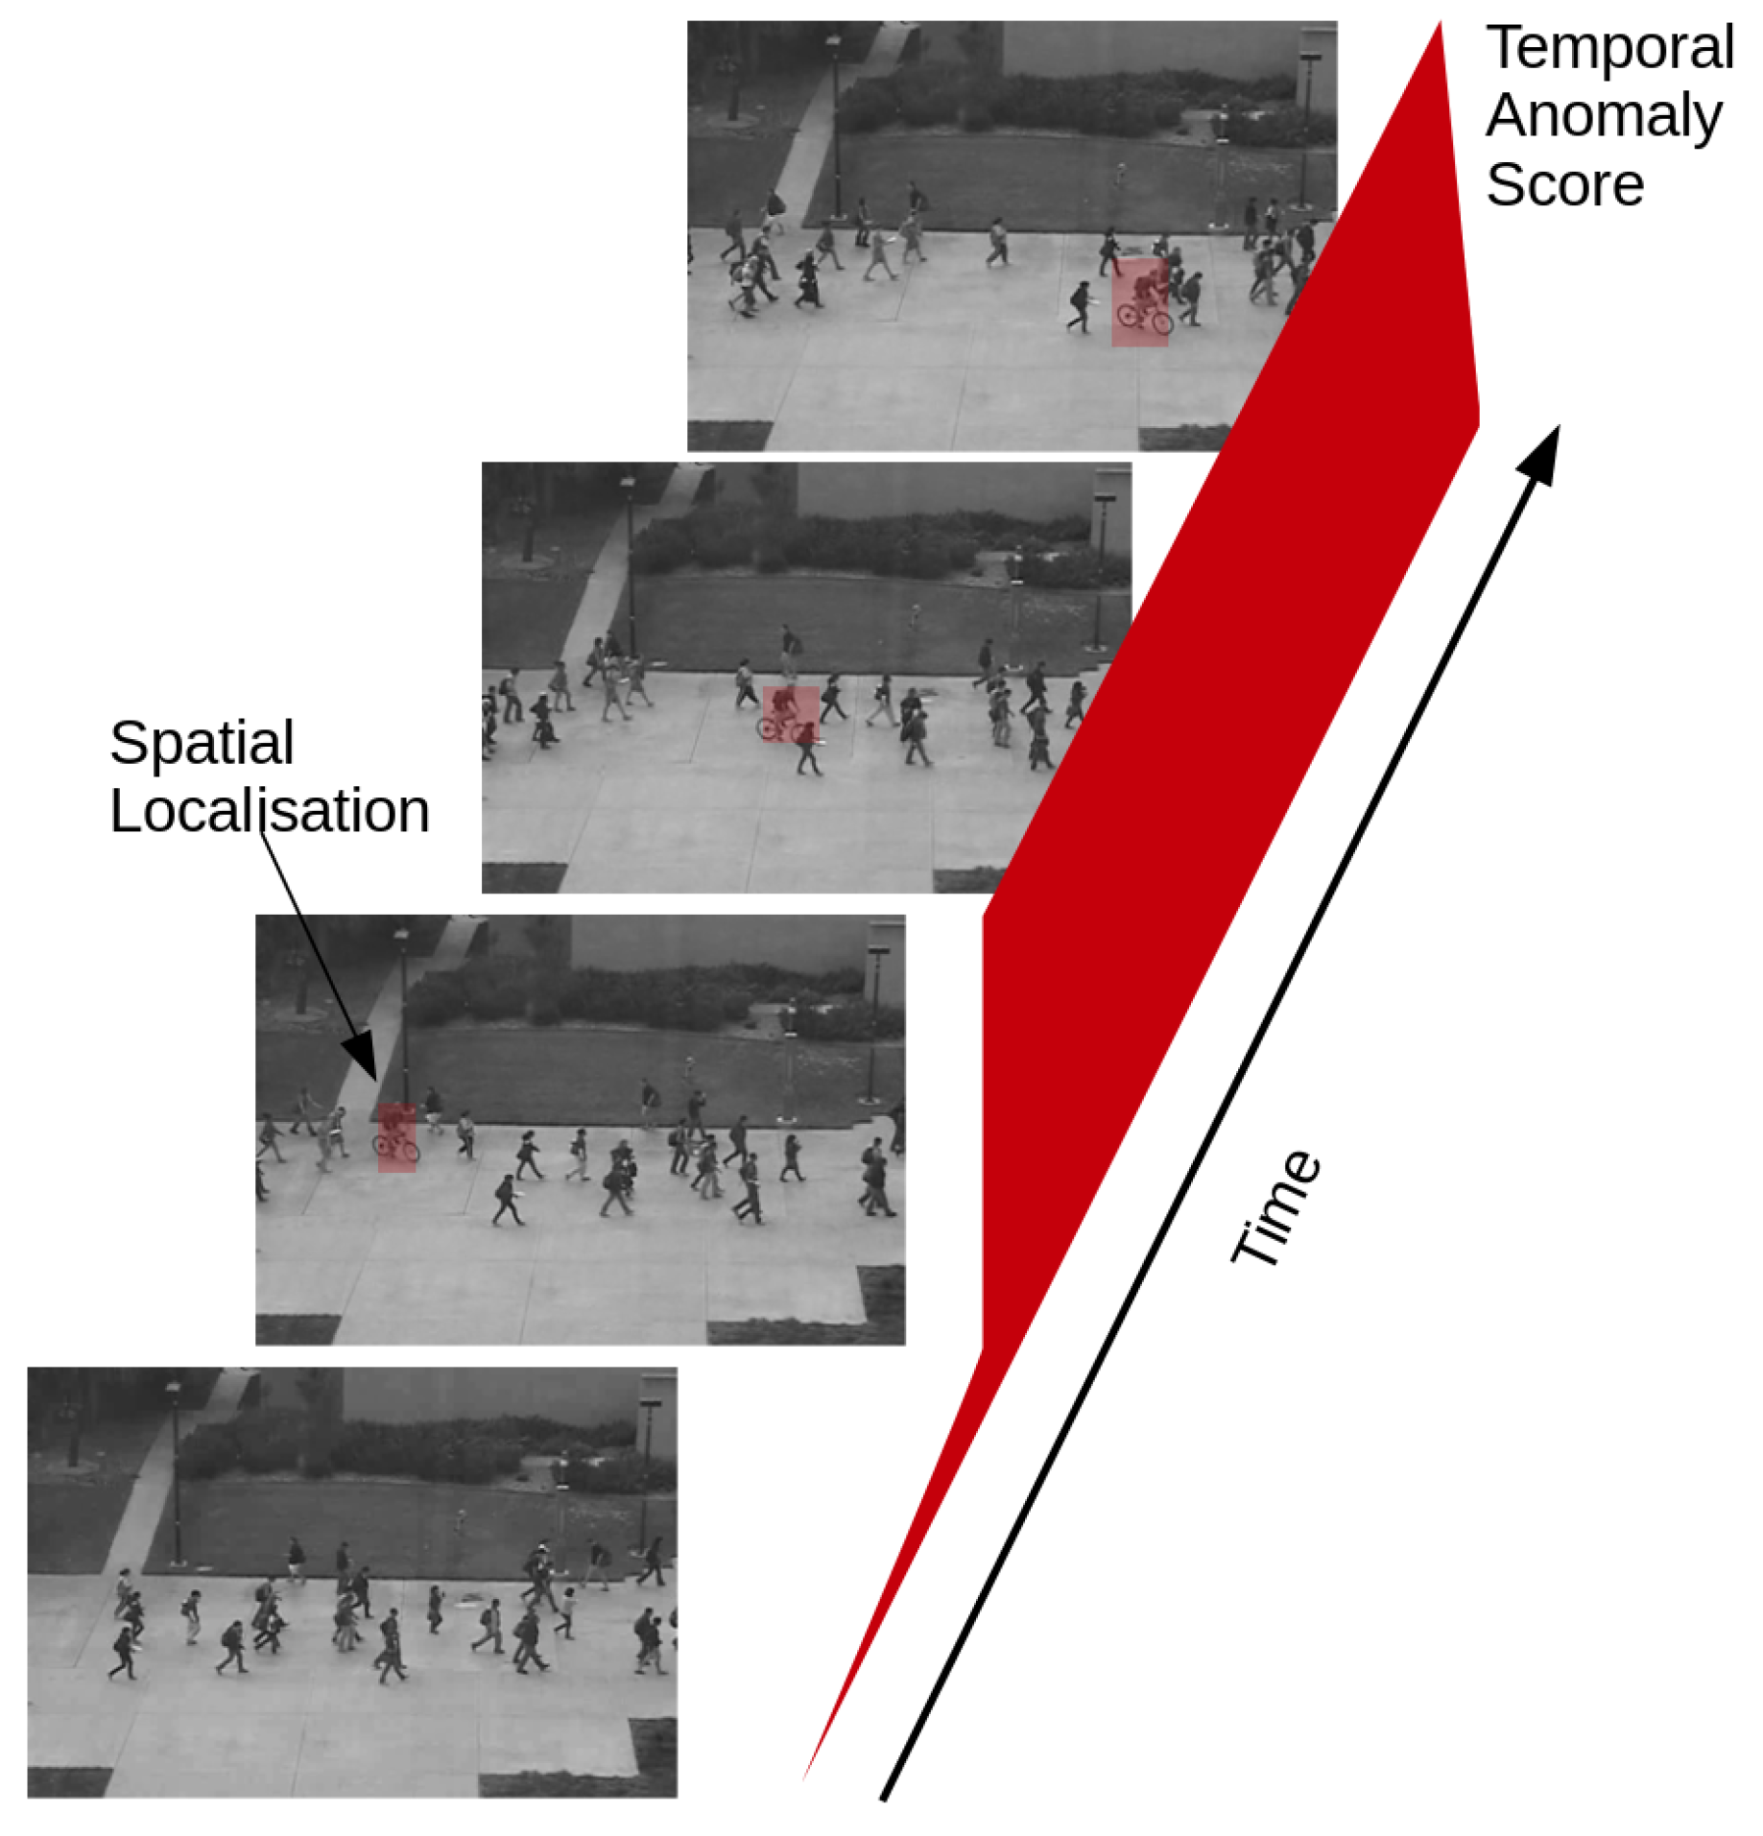
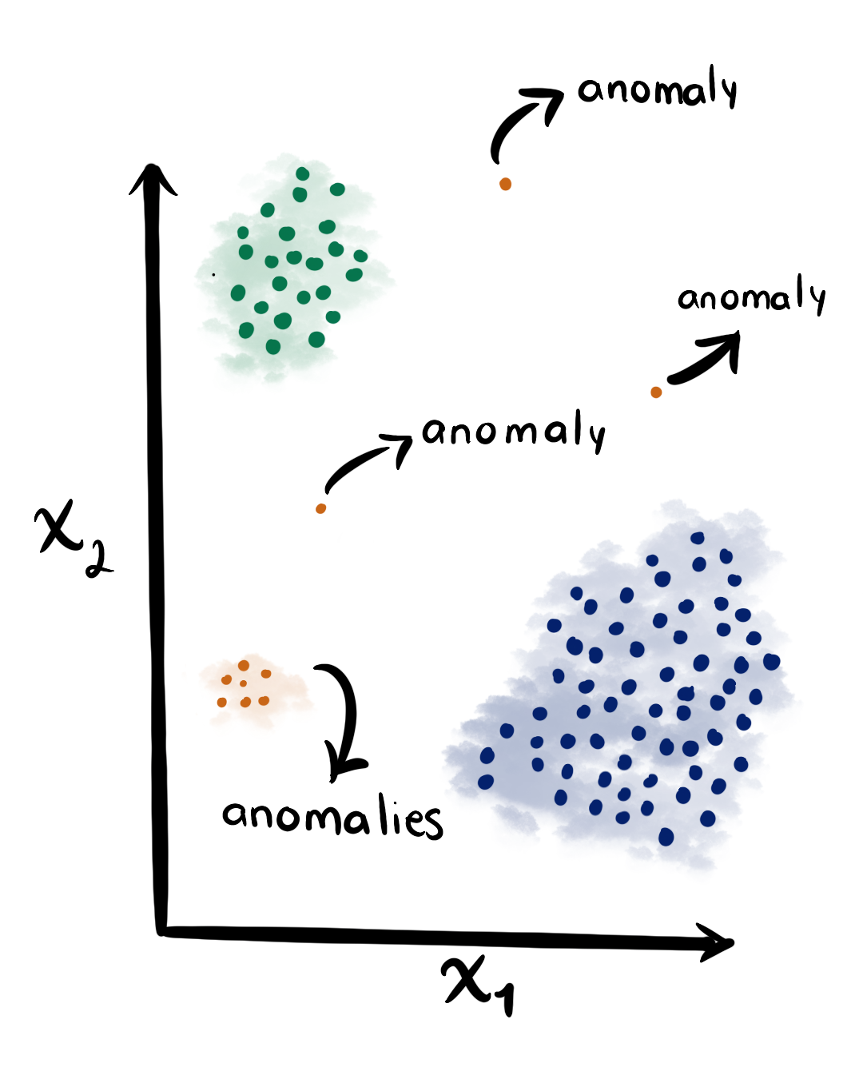
Applications of Unsupervised Learning
Anomaly Detection
Notes:
Anomaly Detection

Slide 16
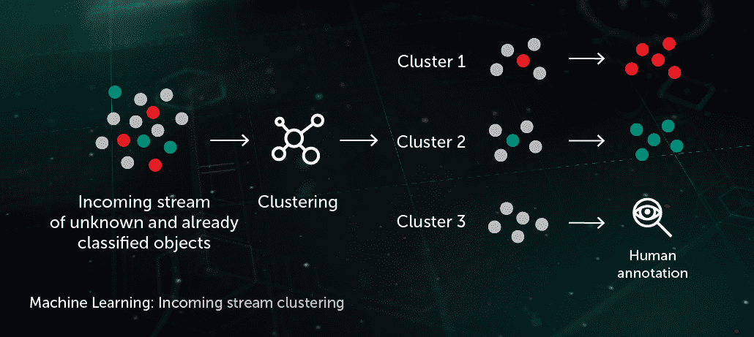
Applications of Unsupervised Learning
Cyber security (data preparation for unknown threats)
Notes:
Cyber security
Unsupervised models help cyber security professionals identify, group and label their programmes' vulnerabilities. As a result, they can react to security breaches more quickly. Typically, the cyber security industry uses anomaly detection techniques to identify potential threats and attacks. By using unsupervised ML, they can also make sure their algorithms constantly work to discover new potential ways to store data securely.

Slide 17
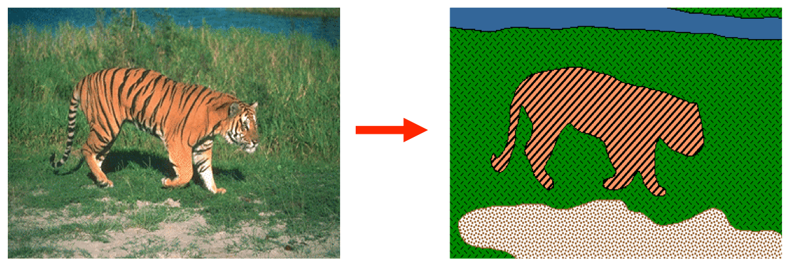
Applications of Unsupervised Learning
Preparing data for supervised learning (Image segmentation)
Notes:
Data Prepration

Slide 18
Unsupervised ML Approaches
Clustering: identifies similarities and differences between unlabelled data entries and groups them based on their properties.
Dimensionality reduction: reduces some data while maintaining the integrity of a data, when there's so much data to analyse which may reduce the algorithms' performance.
Association: can find relationships between variables, i.e. identifies sets of items which often occur together in a dataset

Slide 19
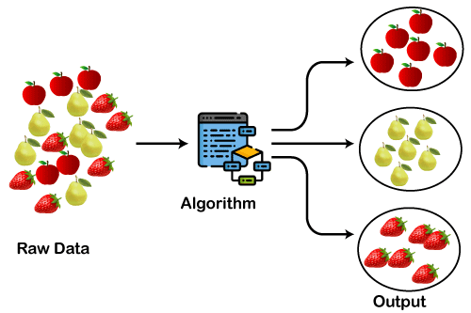
Unsupervised ML Approaches
Clustering: identifies similarities and differences between unlabelled data entries and groups them based on their properties.

Slide 20
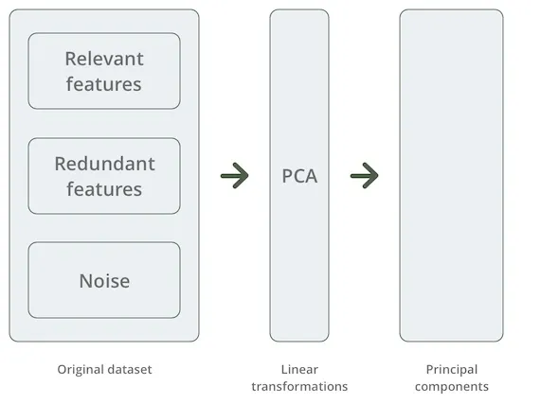
Unsupervised ML Approaches
Dimensionality reduction: reduces some data while maintaining the integrity of a data, when there's so much data to analyse which may reduce the algorithms' performance.

Slide 21
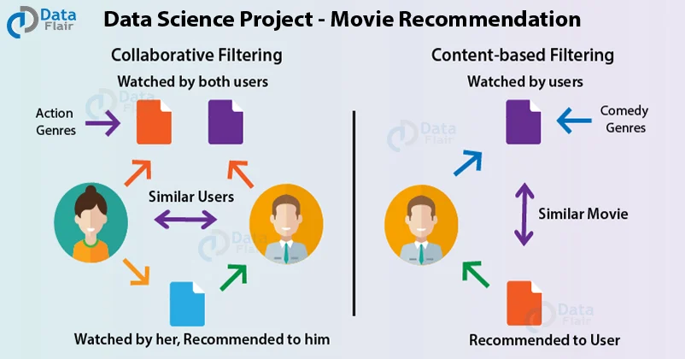
Unsupervised ML Approaches
Association: can find relationships between variables, i.e. identifies sets of items which often occur together in a dataset

Slide 22
Clustering
K-means Algorithm

Slide 23
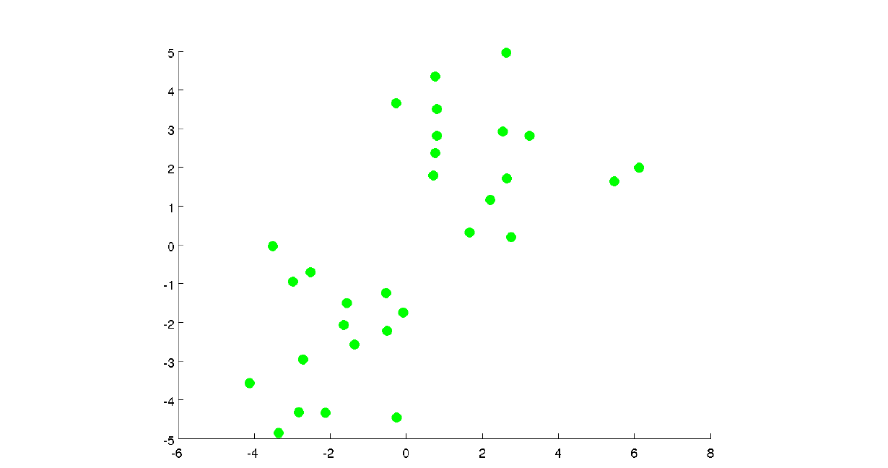
K-means Clustering
Motivation:
to summarize a complex real-valued data point with a single categorical variable

Slide 24
K-means Clustering

Slide 25
K-means Clustering
Is an Iterative algorithm
that divides a group of n datasets
into k different clusters/ subgroups
based on the similarity and their mean distance from the central point (centroid) of that particular subgroup/ formed.

Slide 26
K-means Clustering
Start:
Pick K random points as cluster centeroids.
Here,
K = 2

Slide 27
K-means Clustering
Iterative Step 1
Assign data points to closest cluster centroid

Slide 28
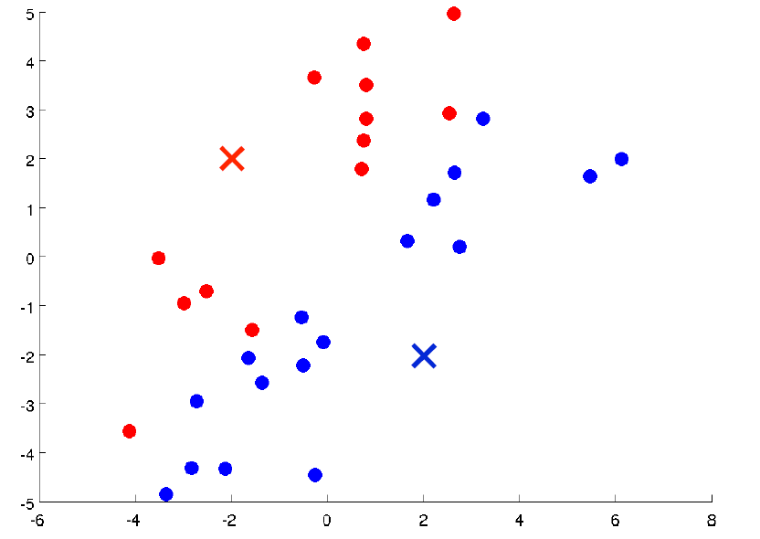
K-means Clustering
Iterative Step 2
Compute the average position of all data points assigned to a centroid

Slide 29
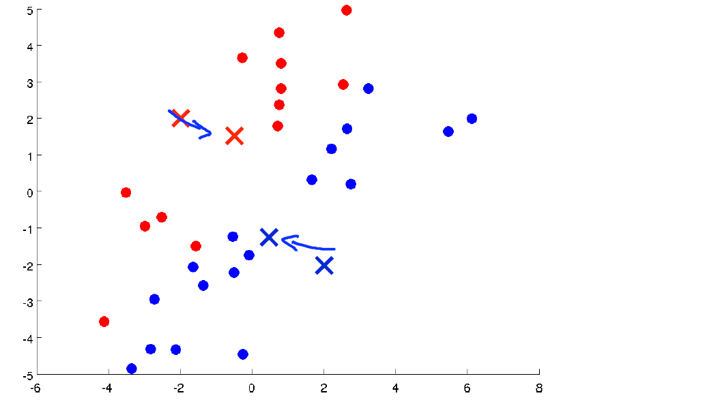
K-means Clustering
Iterative Step 3
Move the cluster centroid to the average of the assigned points

Slide 30
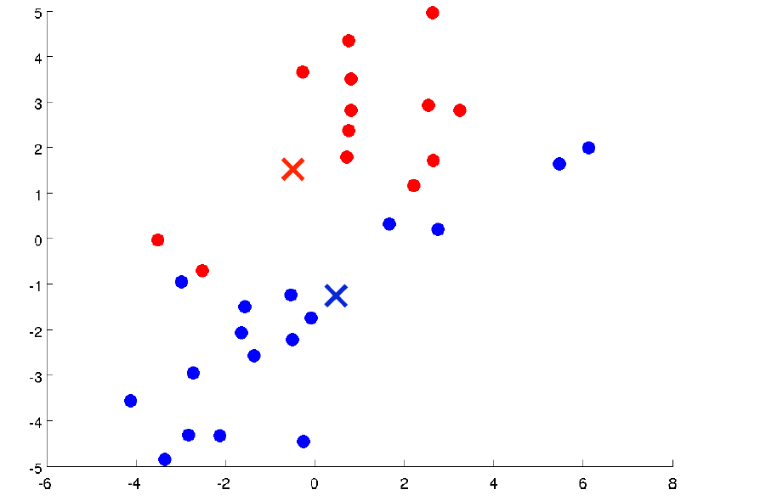
K-means Clustering
Repeat:
Calculate average of data points
Move centroid to the new average position

Slide 31
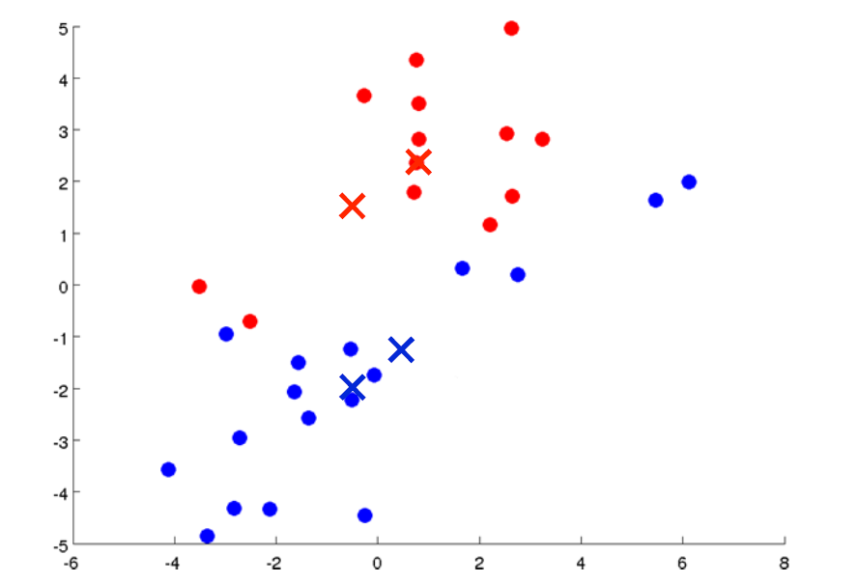
K-means Clustering
Repeat:
Until Convergence
i.e. Reassignment of data points occurs

Slide 32
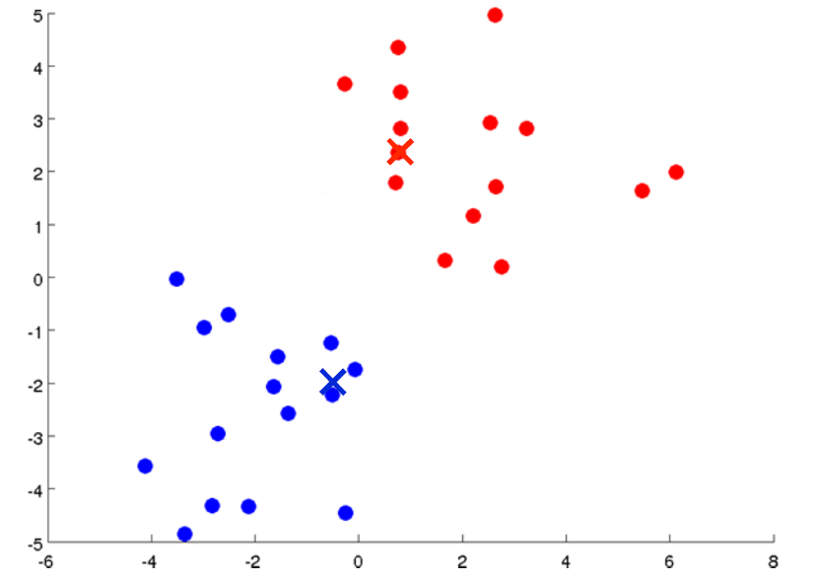
K-means Clustering
Repeat:
Until Convergence
i.e. Reassignment of data points occurs

Slide 33
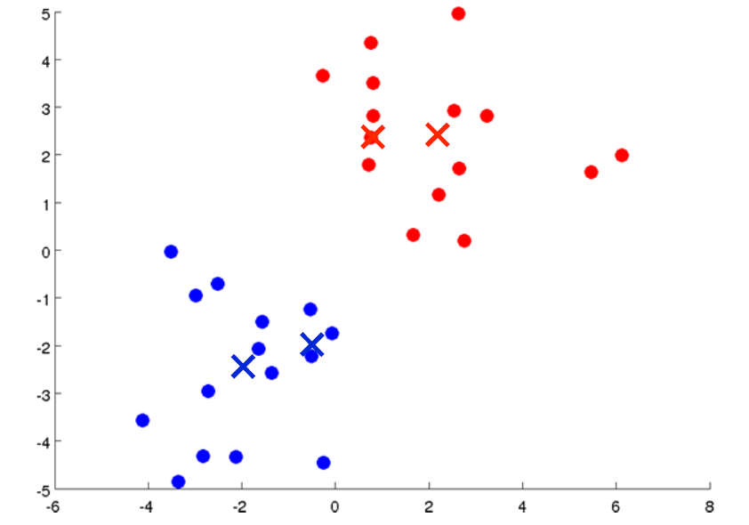
K-means Clustering
Repeat:
Until Convergence
i.e. Reassignment of data points occurs

Slide 34
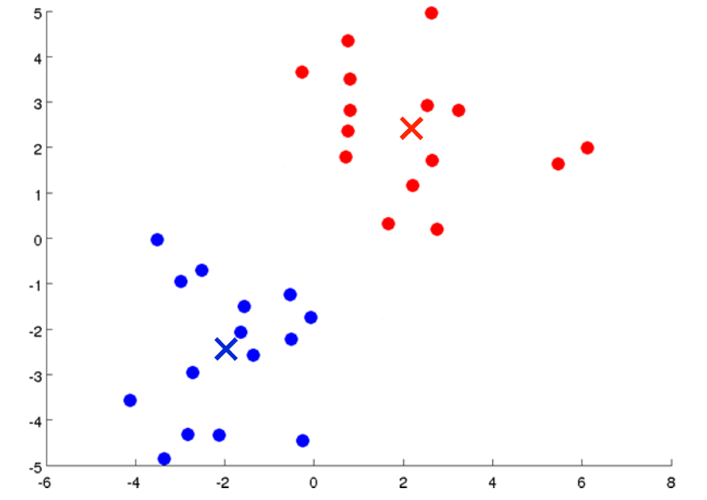
K-means Clustering
Repeat:
Until Convergence
Converged
or
Not Converged?

Slide 35
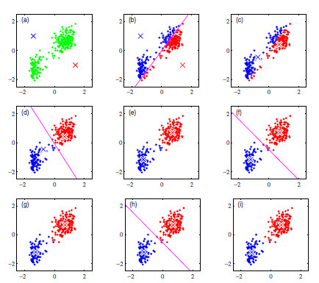
K-means Clustering
Notes:
https://user.ceng.metu.edu.tr/~akifakkus/courses/ceng574/k-means/
https://www.naftaliharris.com/blog/visualizing-k-means-clustering/

Slide 36
When K-means Algorithm ends?
No re-assignment of the data points occurs
No relocation/ re-positioning of centroids

Slide 37
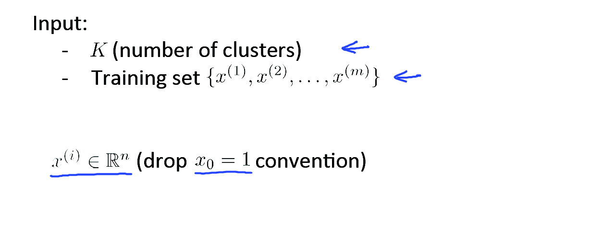
K-means Algorithm

Slide 38
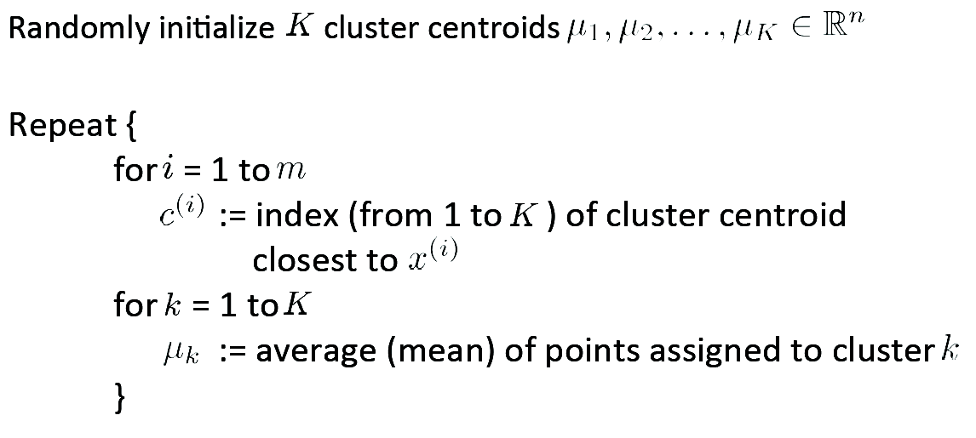
K-means Algorithm
For all data points of training data:
Find closest centroid c^{(i)}
Average of points is recomputed for all centroids relocation

Slide 39
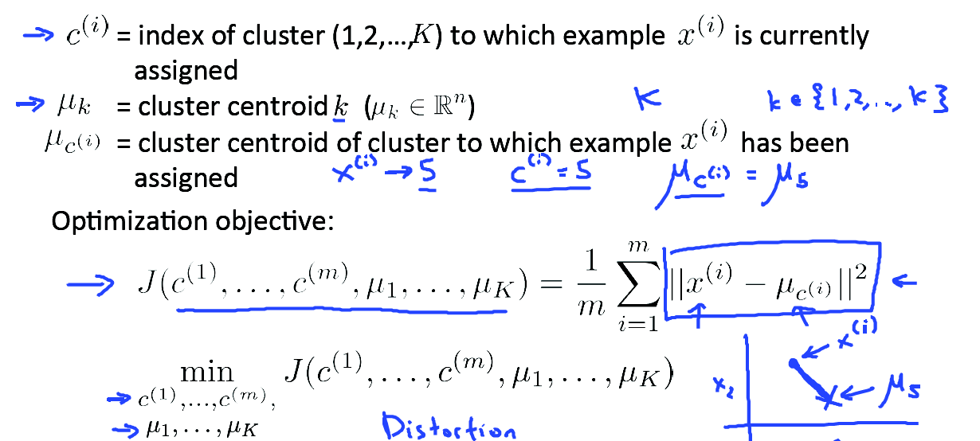
K-means Optimization Objective
x^{(i)} training example i
u_{c}^{(i)} cluster centroid of x^{(i)}

Slide 40
Using K-means Clustering
from sklearn.cluster import KMeans
kmeans = KMeans(n_clusters=k, **kmeans_kwargs)
kmeans.fit(features)

Slide 41
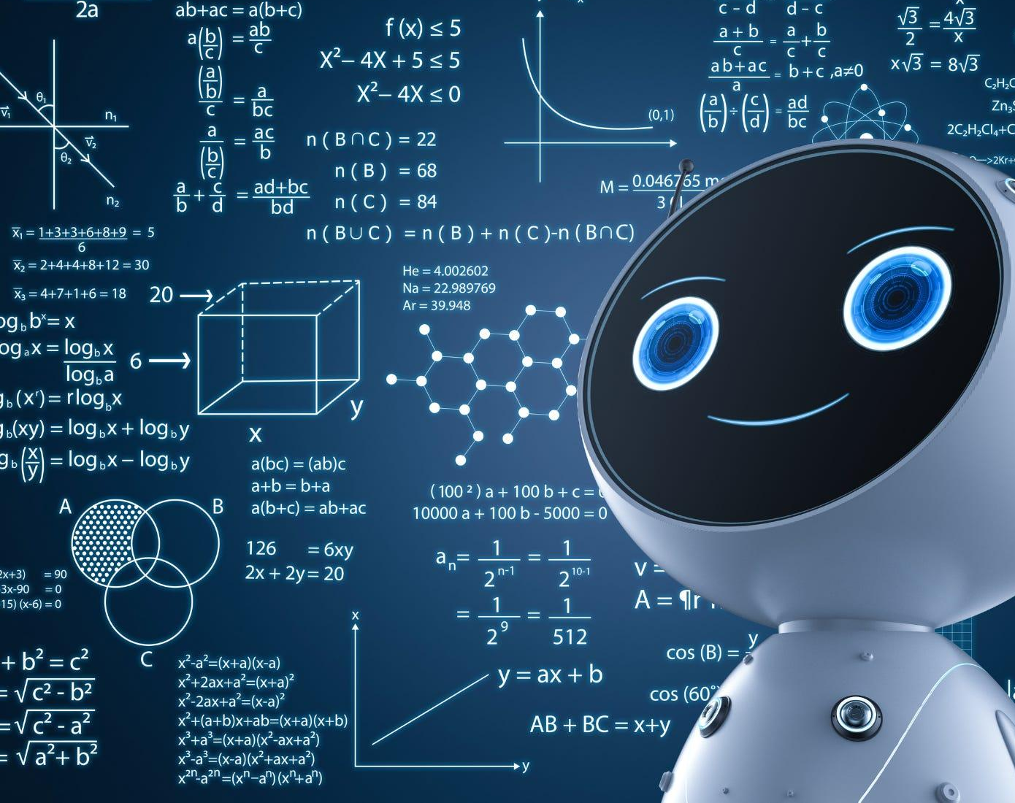
Happy Learning!

